Slide 1
Scholar Plot – Data Visualization Method for Scientific Careers
Kyeongan (Karl) Kwon
PhD Proposal
Advisor: Prof. Ioannis Pavlidis
Feb 2016
Notes:
Hello everyone, Thank you for coming today for my PhD proposal. My name is Kyeongan and I go by Karl.
I am a 5th year phd student in computer science and I am working at CPL advised by Prof. Pavlidis.
Today, I am going to present my research about ‘data visualization methods for scientific careers’

Slide 2
Exploration vs Explanation
Visualization for exploration, When you don’t (yet) have a story to tell.
Visualization for explanation, when you have a story to tell.

Slide 3
Overview
Introduction
Design and Methodology
Demo – www.ScholarPlot.com
Engieneering
Conclusion and Future Work
Acknowledgment
Notes:
Here is overview about the presentation

Slide 4
What is Data Visualization?
Data visualization is the presentation of data in a pictorial or graphical format.
Facilitate intuition
Support qualitative analysis
Notes:
Before start to present my research, I would like to talk about a little bit what data visualization is exactly.
Data visualization is the graphical display of abstract information for two purposes: sense-making (also called data analysis) and communication.
visual face.

Slide 5
Why Data Visualization Matters?
Visualization makes data accessible.
Quickly notice something out of position, patterns and pattern violations.
Visualization gives faster access to actionable insights.
Visualization allows access to huge amounts of data.
Notes:
Because of the way the human brain processes information, using charts or graphs to visualize large amounts of complex data is easier than poring over spreadsheets or reports.
Data visualization is a quick, easy way to convey concepts in a universal manner – and you can experiment with different scenarios by making slight adjustments.
(trends, gaps, outliers)

Slide 6
Data Visualization vs. Infographics
Data Visualization – by software
Infographics – by hand
X
Notes:
I would like to point out the difference between Data visualization and Infographics because many people are confused these two terms. Data Visualizations are far more likely to be generated automatically through the use of algorithms or computer programs. Infographics are manually drawn by Designers through the use of illiust

Slide 7
Introduction
Appraising academic careers
Hiring faculty
Promotion and Tenure
Peer-reviewing
Matching student to advisor
Notes:
A Good Research Problem
when doing such things, many people refer to CV,

Slide 8
Introduction
A curriculum vitae (CV)
Length
Often convoluted
With potential errors / misses
Inconsistent
Difficulty and time consuming to analyze academic CVs.
What methods that solve these issues.
Data Science / Data Analytics / Data Visualization
… 30, 40, 50 ... pages
Notes:
CVs are used in academic positions, where your publishing and research history as well as your memberships and fellowships
convoluted - extremely complex and difficulty to follow
(complicated)
It is relatively difficult and time consuming to thoroughly analyze academic CVs.
Graduate students in search of a Ph.D. advisor
Aspiring faculty in search of a fitting department
Reviewers in a funding agency assessing a proposer’s record
So we came up the idea how we can solve this problem.
One thing we can approach is Data science. More specially, data visualization is right method for this purpose.

Slide 9
Goals of Research, Motivation
Understand how people use visualizations to gain insight
Design principles and techniques for effective visual analysis systems
Visualizations techniques
Visualizations tools

Slide 10

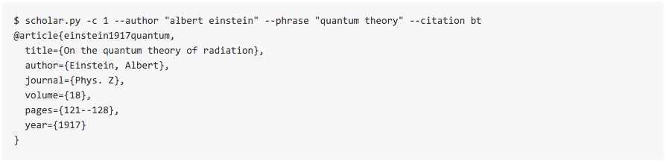
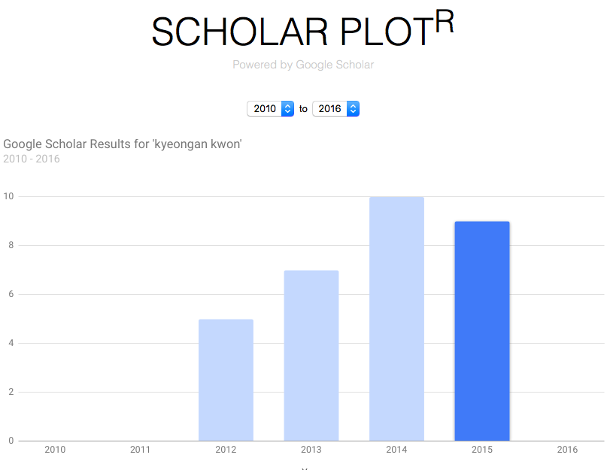
Related work
Google Scholar – Free, All inclusive but only publications
Scopus - Login Required to Access Scopus in your institution's network
ORCID - Individuals need to set up
scholar.py - A parser for Google Scholar
Scholar Plot^{R}
Notes:
Google Scholar
Free, All inclusive
Only publications
Scopus
Login Required to Access Scopus in your institution's network
Only publications
ORCID
Individuals need to set up

Slide 11
What is missing
Summary Interface
No articulating philosophy about academic merit
Scholar Plot fills the gap
Visual summary
Solid scheme for academic merit

Slide 12
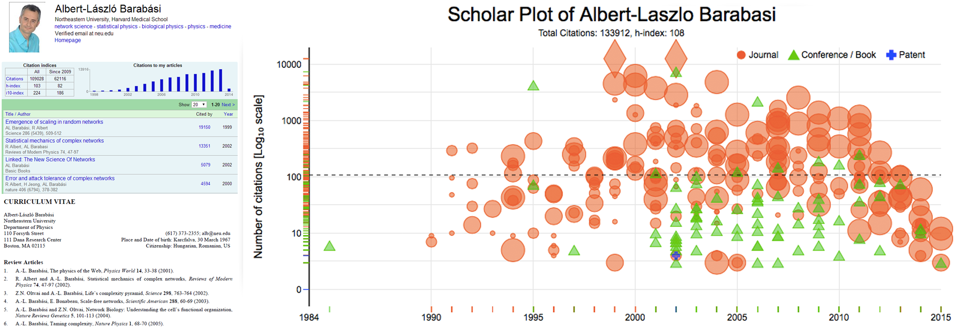
Design and Methodology
A: Google Scholar Profile
C. Scholar Plot
B: Curriculum Vitae
Notes:
I have three figures of the same scholar in order to see the difference.
Google Scholar Profile. It is the most inclusively data
Curriculum Vitae, a brief account of a person's education, qualifications, and previous experience. It is still very popular. However, user needs to make themselves as PDF and always need to update it whenever new publications apperared.
Here, I want to ask you what these are missing?
- One when is the first and least publication they are publicshed.
– Another is you have no idea that
Quick comparison Google Scholar, Curriculum Vitae and SP
scientfic evidenace / crucial factors / justify why it is being considered.

Slide 13
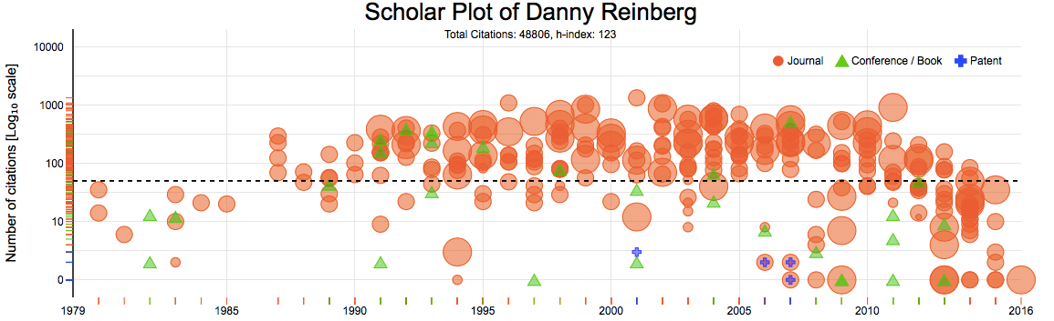
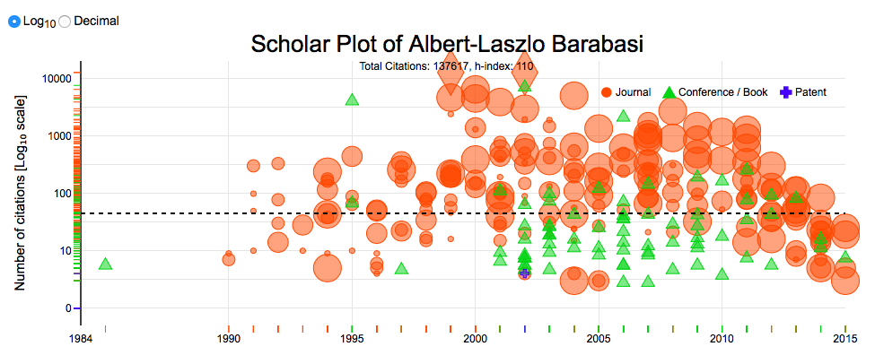
Design and Methodology
Notes:
(Details as much as possible)
This is one result of a scholar who have about 300 publications includes all Journal/ Conference and Patents.
I am sure that most of people includes you understand this visual results tell
It is easy to identify what type of publication powers the individual’s scholarship - a correlate of disciplinary culture. For example, it is easy to spot career profiles of computer scientists and engineers, where typically scholarship is built on conference rather than journal publications.

Slide 14
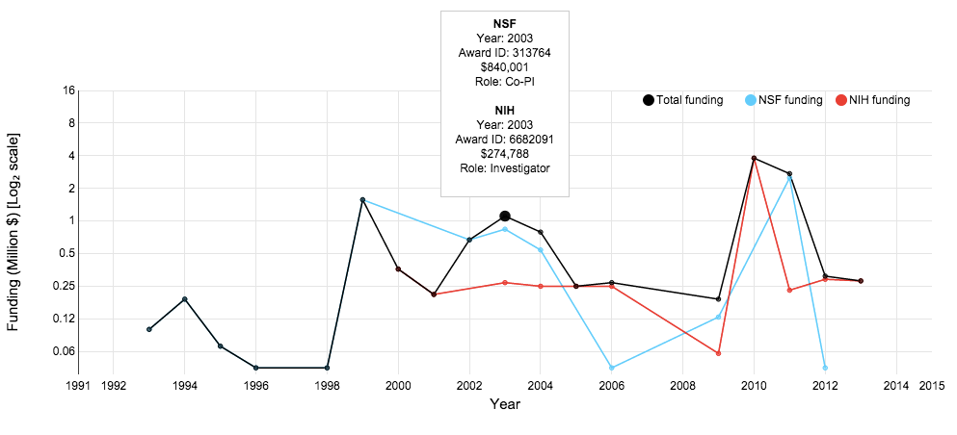
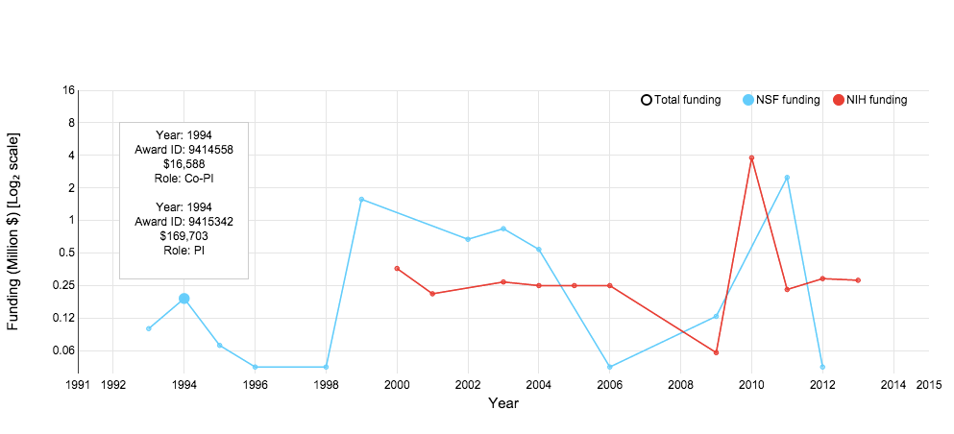
Design and Methodology
Funding results of NSF, NIH, NASA data
NSF: FY 1985 - FY 2013 (29 years, 312,311 rows, 10,769/year)
NIH: FY 2000 - FY 2013 (14 years, 777,657 rows, 55,456/year)
NASA: FY 2007 - FY 2015 (9 years, 16,670 rows, 1,852/year)
Tooltip displays
Agents, Year, Award ID, Amount and Roles such as PI, Co-PI, Investigator
Notes:
Scholar Plot also depicts the NSF/NIH/NASA funding of an individual as a multiline in log₂ scale

Slide 15
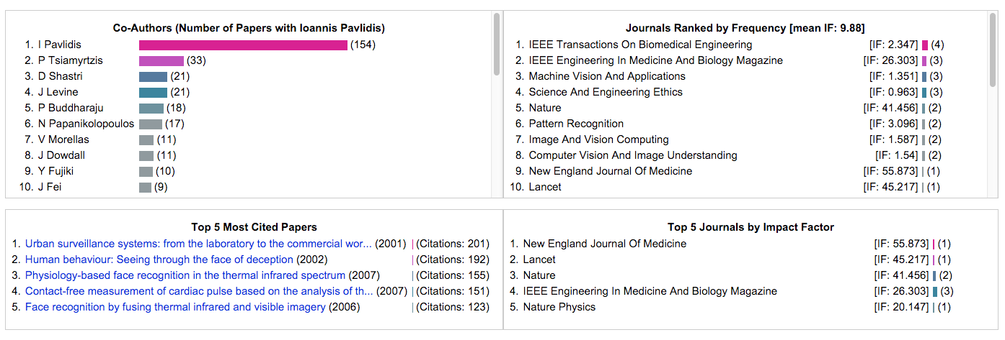
Design and Methodology
Focus group feedbacks from social scientists at Northwestern University.
Four ancillary panels
Notes:
Initial feedback through a focus group, we’ve added 4 panels below scholar plot results.
It consists of 4 panels.
Interface team science information. Participants wanted to see the number and intensity of collaborations for the depicted scholar.
Summarize highly cited papers. Participants wanted to see explicitly in a side panel the scholar’s most popular papers.
Interface journal profile. Participants wanted to see the specific journals where the scholar publishes most often and their impact factors.

Slide 16
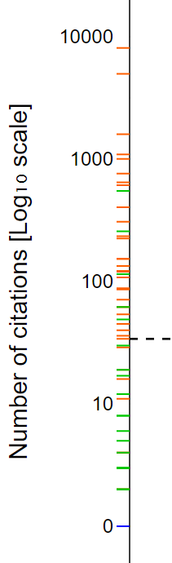
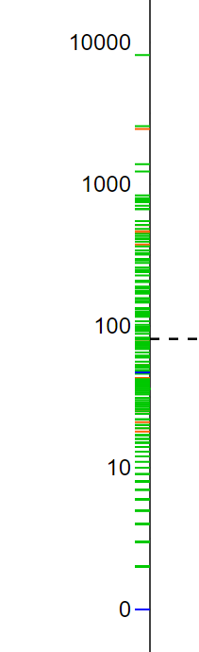
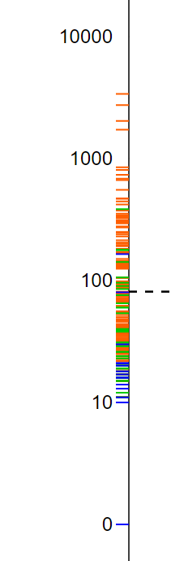
Design and Methodology
Vertical Distribution
A: Some Conference and Journal Papers
B: Focused on Conference Papers
C: Journals and Some Patents
Why this is useful?
You can see and tell their stories briefly.
A
B
C

Slide 17
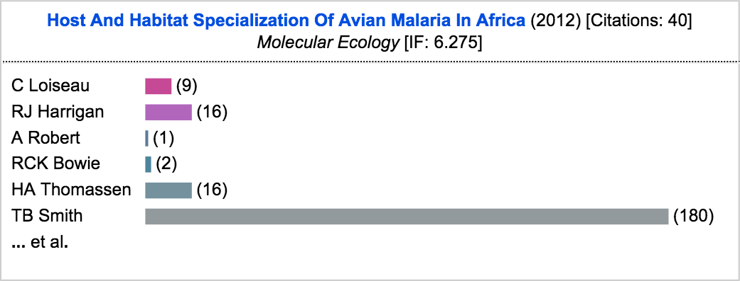
Design and Methodology
Tooltip interacting with details
Title, Year of Publication, Citation number, Journal [Conference, Patent] name and Impact Factor value
Co-Author list by order and the horizontal visual bars to tell how many times each author has been collaborated.
Notes:
We have another feature that interact an each plot.
When you interact with a plot, it shows the tooltip, which includes paper title, year of publication, the number of citations, journal or conference name and journal impact factor.
this is optional

Slide 18
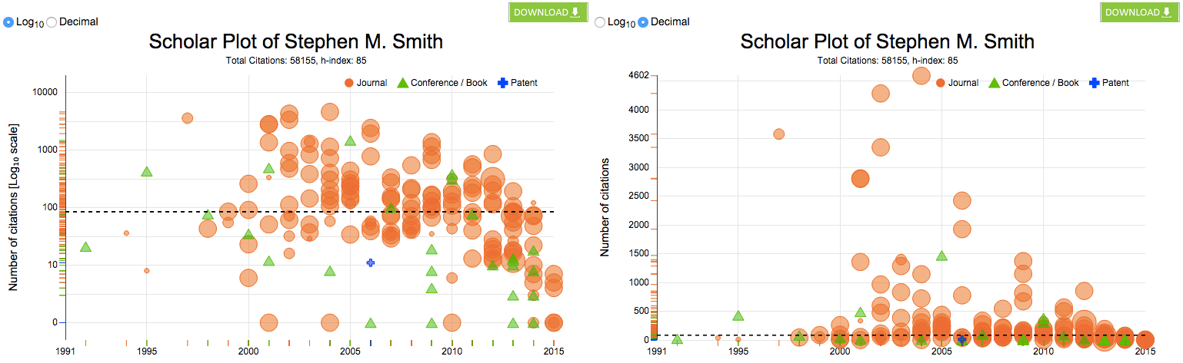
Design and Methodology
Scale Views to create a standardized scale for the y-axis for comparison
Log10 (Default)
Decimal
Notes:
Individual SP publication plot has two different scales views to create a standardized scale for the y-axis for comparison, we introduced a log10 scale for the default plot and an option to toggle to the decimal scale view.

Slide 19
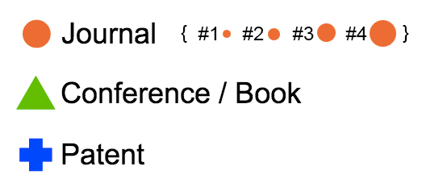
Design and Methodology
Publication symbols
Journal (A ~ r²)
Conference / Book
Patent
Journal sizes
IF bracket ( IF < 2) - #1
IF bracket (2 ≤ IF < 4) - #2
IF bracket (4 ≤ IF < 16) - #3
IF bracket (IF ≥ 16) - #4
Notes:
I want to talk to publication symbols and its size.
Only journal publications have a widely accepted ranking system that is the Journal Impact Factor (IF) List.
So, we represent different publication types with different symbols, varying the symbol size of journal publications only, for which an established ranking system exists.
- We chose disks to be the symbols of journal publications, as disk scaling can be done very effectively by simply varying its radius (A ∼ r2).
Specifically, after performing histogram analysis on the IFs of journal publications, we settled on four disk sizes to represent journal prestige: #1 < #2 < #3 < #4 (Fig. 2). We found that the great majority of journal publications appear in journals with IF < 2, assigning to this cohort the smallest disk size symbol, #1. These are mid- level specialized technical and scientific journals.
The next IF bracket (2 ≤ IF < 4) includes high quality specialized technical (e.g., IEEE Transactions) and scientific journals represented by disk #2.
The third IF bracket (4 ≤ IF < 16) includes very high quality science journals and specialized medical journals represented by disk #3.
The top IF bracket (IF ≥ 16) includes famous general science journals (e.g., Nature) and top medical journals (e.g., New England Jour- nal of Medicine); they are assigned the largest disk, #4.

Slide 20
Demo
Scholar Plot
Notes:
5-8 mins
Now, I want to talk about the engineering part.

Slide 21
Data collection methods
Scholar Data
Collection
Clean
Funding and Impact Factor Data
Download, Search
Extract and parse using xmlstarlet
Design RDMBS (MySQL)
Notes:
I want to talk about the engineering part.
Scholar’s publication data is at from Google Scholar Profile and publication data. I used the

Slide 22
Data collection methods
NSF: FY 1985 - FY 2013 (29 years, 312,311 rows, 10,769/year)
NIH: FY 2000 - FY 2013 (14 years, 777,657 rows, 55,456/year)
NASA: FY 2007 - FY 2015 (9 years, 16,670 rows, 1,852/year)
Where to download, How to clean, What to have

Slide 23
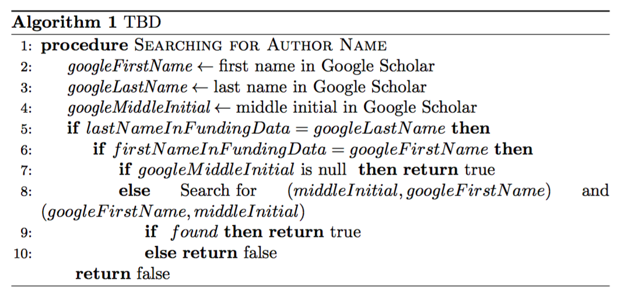
Name Disambiguation
Google Scholar includes many different cases on its page of papers
Ioannis T Pavlidis
IT Pavlidis
I Pavlidis
Ioannis Pavlidis
Notes:
The algorithm applied to the system to match funding data

Slide 24
System Architecture
Notes:
(30 secs – 1 min)
I do not go through the system. However, I myself want to mention because this system is built very well and took lots of efforts to have it. Frontend Development, MySql Databse, Many Datbase programming, Scrapping information from Google by avoiding blocking. I can’t list all but we even blocked morn than 10 times. We had have ‘sleepless night’

Slide 25
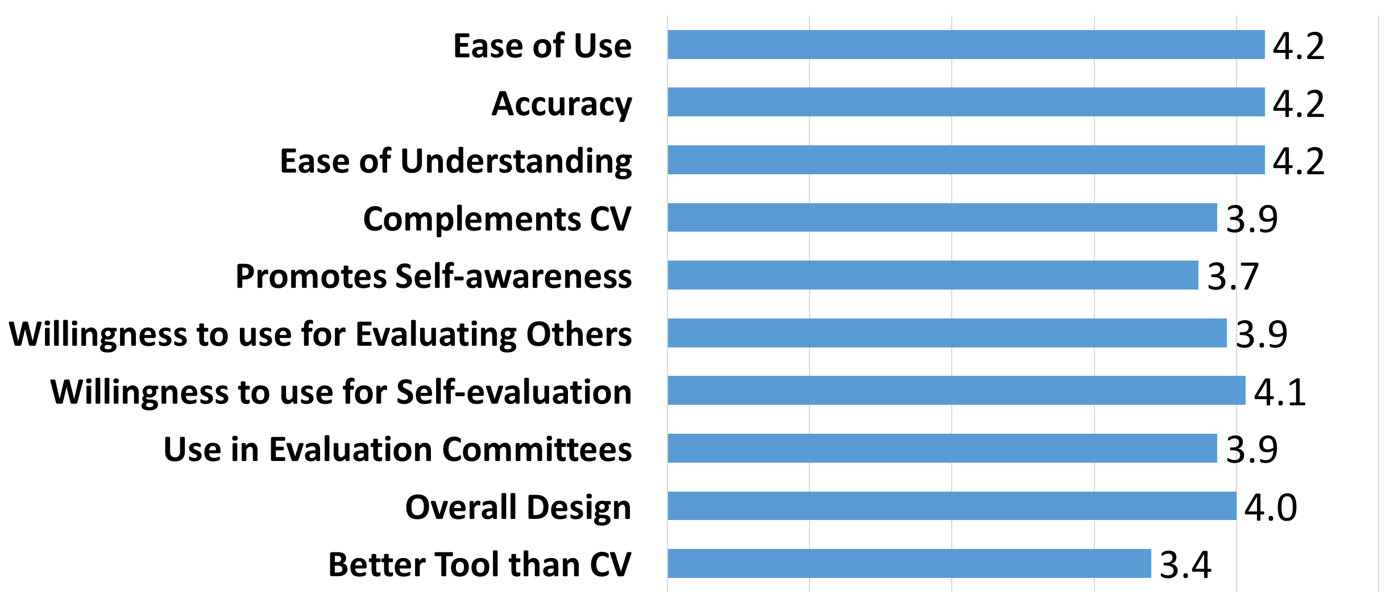
Usability Study
Participant (n=15) including Graduate, Post Doc, and Faculty
From various natural, mathematical, and social sciences.
Likert scale from 1 to 5, with 1 being strongly disagree and 5 begin strongly agree
Overall, it is a user friendly tool that academic users find of interest and value.
Notes:
A total of n = 15 participants from various natural, mathematical, and social sciences participated in the user study, which was approved by the Institutional Review Board (IRB) of the University of Houston.
We asked each participant to review and interact with the SP interface before completing an online survey.
The participants answered 10 questions on a Likert scale from 1 to 5, with 1 being strongly disagree and 5 being strongly agree.
Usability, accuracy and intuitive understanding of SP scored the highest (μ = 4.2).
Another key result is that the participants were planning to use SP frequently (μ = 4.1).
Overall, the survey confirmed that the base level of SP is a user- friendly tool that academic users find of interest and value.

Slide 26
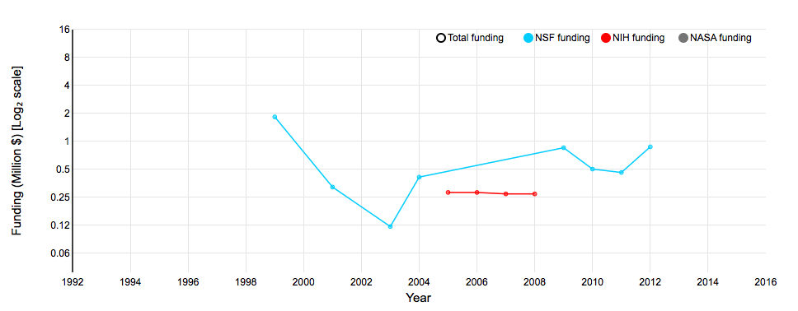
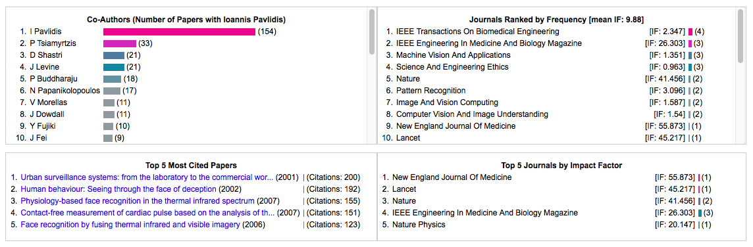
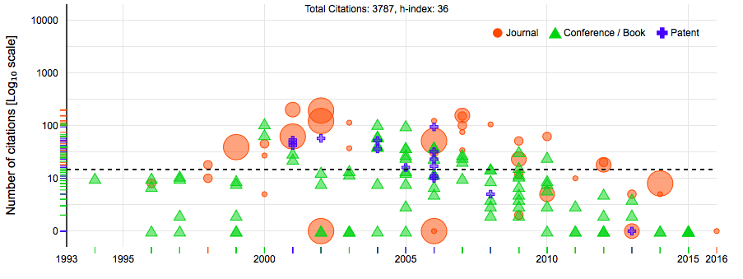
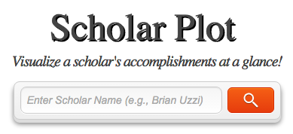
Conclusion
Scholar Plot, a visualization method for academic merit.
Notes:
We presented Scholar Plot (SP), a compact and scalable (individual-department-college) visualization interface for academic merit. We released SP at http://scholarplot.com.
The basic idea behind SP is to facilitate instant deeper insights regarding different strengths of academic records, supporting the work of evaluation committees and the curious academic in search of an advisor or department. One of SP’s strengths is that it draws data from open sources that are inclusive.

Slide 27
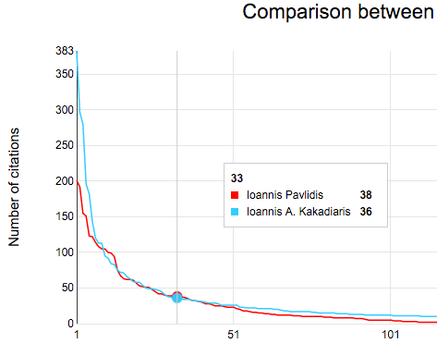
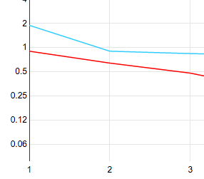
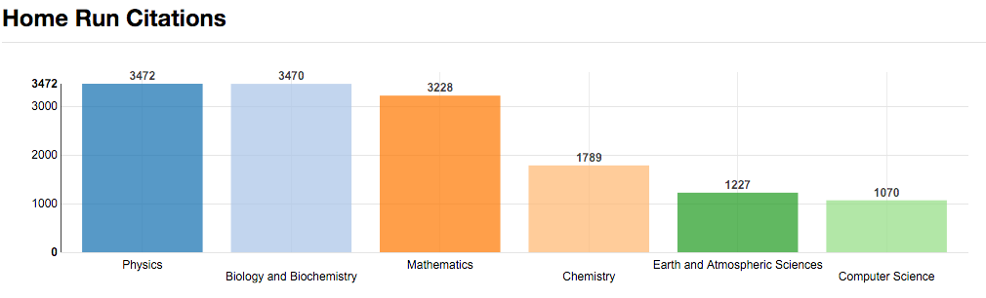
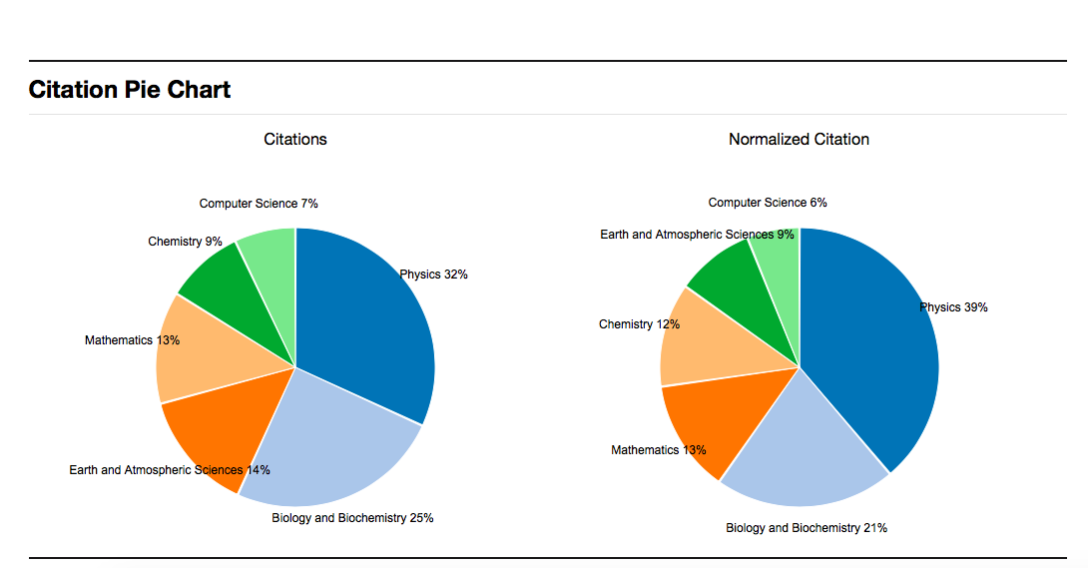
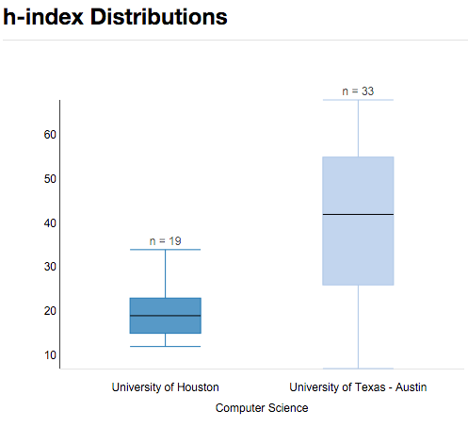
Future Work
Individual
Comparison between two scholars
More agencies if available
Group
Interested in group level
Notes:
We also want to see the group Not only individual but also group such as department, college
JCR Impact Factor update – v.2015 (yearly released)
NSF update – v.2016 (quarterly released)
NIH update – v.2015 (yearly released)
More agencies
More usability survey and refine the product at top-level
What the plan to do
May 2016

Slide 28
PhD Timeline
Fall 2011
Started my PhD
Fall 2013
iPhone app
Graduation
Fall 2015
Fall 2012
User Portrait
Scholar Plot
Proposal
Fall 2014
ACM UbiComp
IEEE VIS
First Publication
GRaSP Poster Presentation
GRaSP Poster Presentation
Notes:
s

Slide 29
References
Introduction
http://www.sas.com/en_us/insights/big-data/data-visualization.html
Related Works
https://github.com/ckreibich/scholar.py
http://www.csullender.com/scholar/

Slide 30
Acknowledgments
Committees
Prof. Ioannis Pavlidis (Dept. of Computer Science at UH) – Chairman
Prof. Ricardo Vilalta (Dept. of Computer Science at UH)
Prof. Zhigang Deng (Dept. of Computer Science at UH)
Prof. Guoning Chen (Dept. of Computer Science at UH)
Prof. Brian Uzzi (Northwestern University)
All our CPL members
Notes:
Management & Organizations

Slide 31
Thank you!
?

Slide 32
Departmental Plot

